Slide 1
Work-in-process Presentation:
Spatial accessibility to the COVID-19 testing sites
and the driven factors behind in NYC
Kelly Anran Zheng

Slide 2

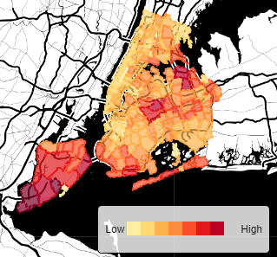

Background
Do New Yorkers have equal access to the COVID testing sites?
If not, what’s the possible reasons?
How does transportation improve the accessibility?
How to solve the medical resource inequity in the future?
Notes:
The outbreak of COVID-19 has reflected some challenges that many cities are facing with, such as the unequal distribution of medical resources and the insufficient supply of COVID testing packages and vaccination. Currently few studies explored the spatial accessibility to COVID testing sites.

Slide 3
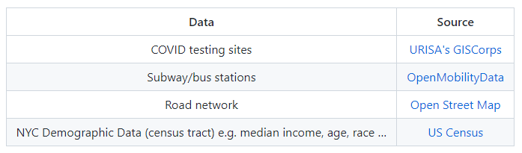
Data
Notes:
At first I choose data of ZCTA level instead of census tract, however, when I was conducting spatial analysis. I notice that ZCTA level is not precise enough. So I switch to census tract level data. NYC has more than 2000 census tract, while 700 hundreds testing sites, which is precise enough to show the spatial disparities of testing sites in different region.

Slide 4
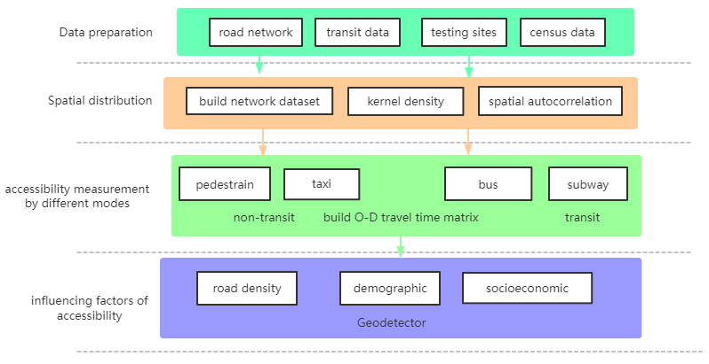
Methods
√
√
Notes:
Here is my workflow for this project. About 80% will be conducted in ArcGIS, together with Python programming. My research basically contain three parts. Now I have finished the data collection and spatial distribution analysis.

Slide 5
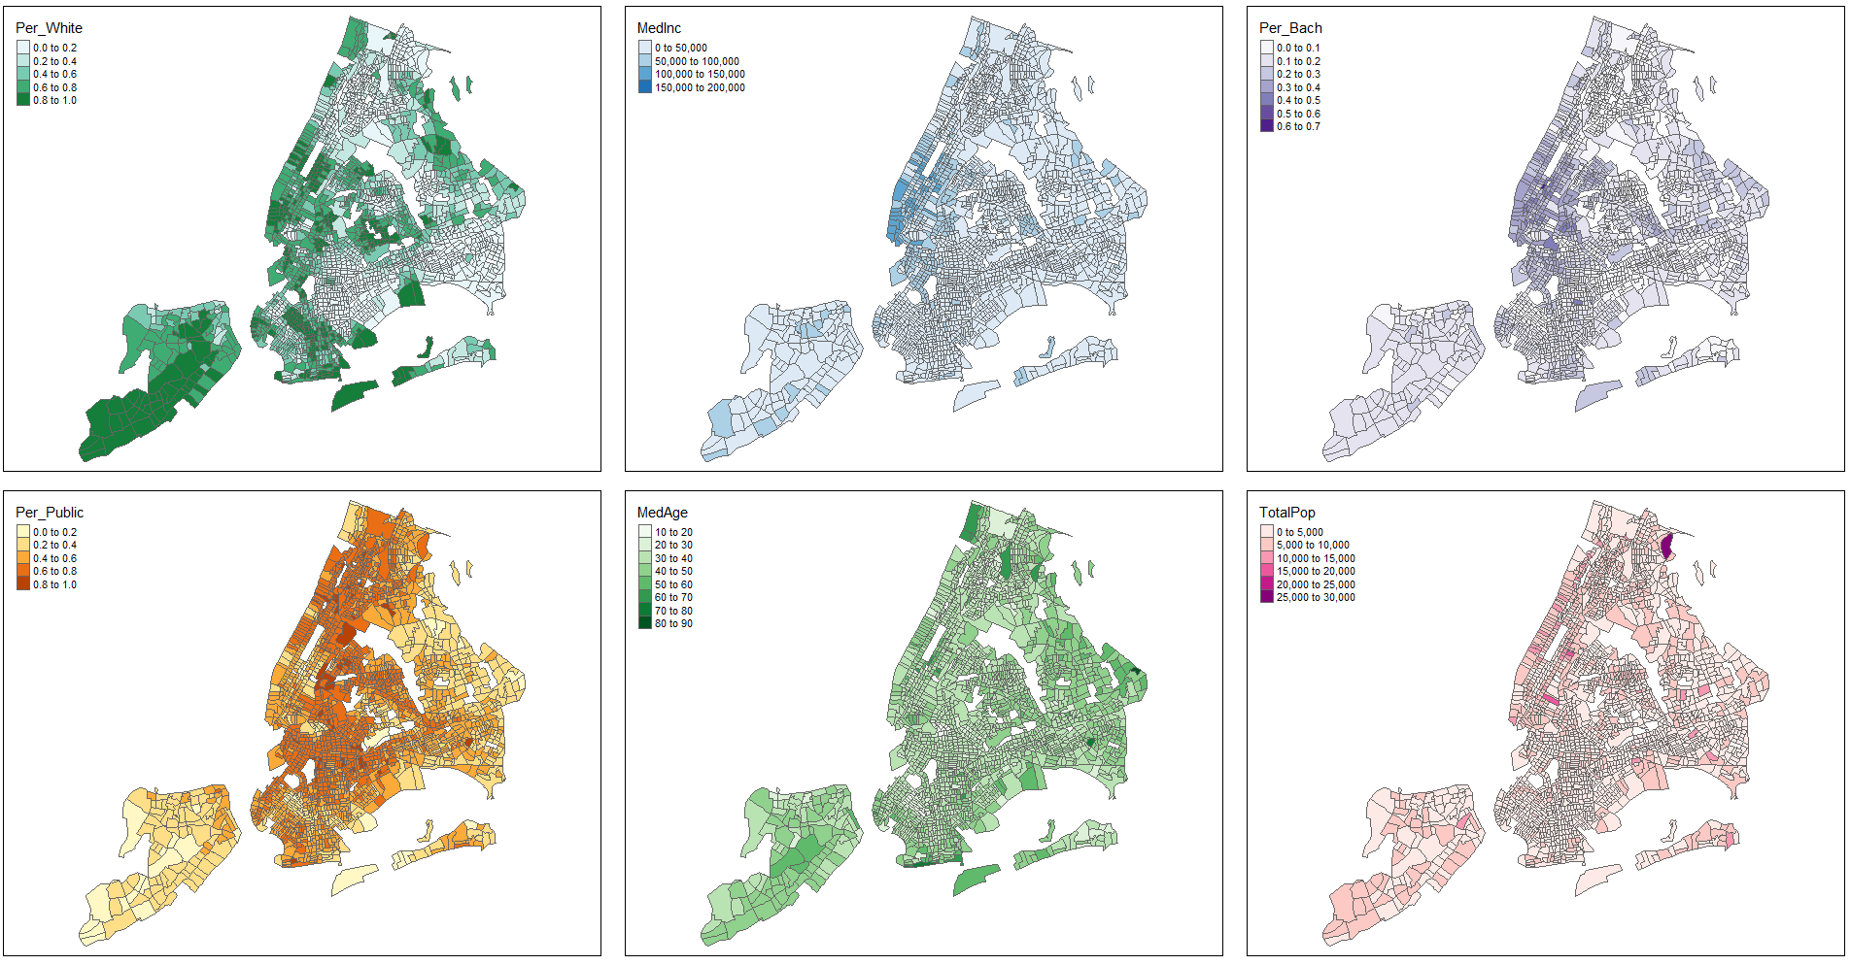
Explanatory Analysis
Notes:
To further explore the relationship between spatial accessibility and its influencing factors, I gathered some demographic and socioeconomic data from US census, like ….

Slide 6
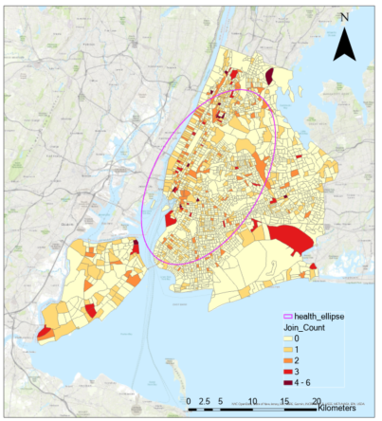
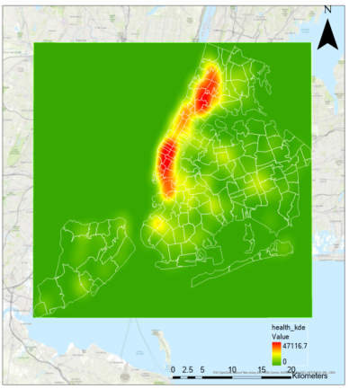
Explanatory Analysis
Notes:
Now I summarized the count of testing sites that contained in each census tract in NYC and also, the kernel density map, It seems that most of testing sites clustered at Manhanttan. The spatial distribution of testing sites seems to be random.

Slide 7
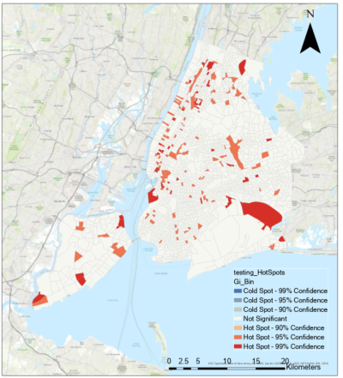
Explanatory Analysis
Spatial Autocorrelation (Global Moran's I)
Global Moran's I Summary
Moran's Index: 0.129344 Expected Index: -0.005650
Variance: 0.001420
z-score: 3.582254
p-value: 0.000341
Notes:
So I then calculate both the global and local Moran’s I. The hot spot distribution is quite uneven in NYC, and the global moran’s I index is about 0.1. SO we can say that …

Slide 8
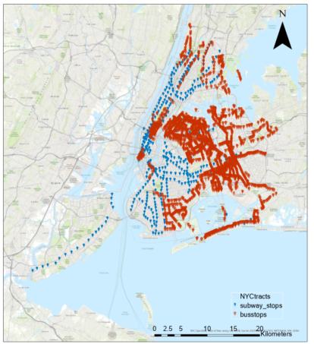
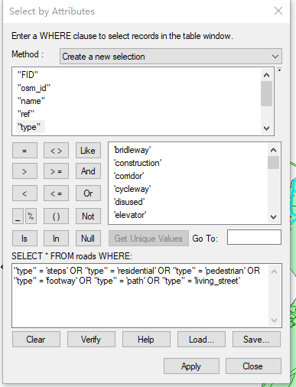
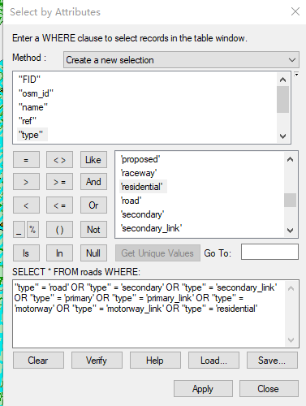
Explanatory Analysis
The subway and bus stations in NYC
Build different road network datasets
Notes:
Currently I am building the road network of pedestrian and vehicles based on the osm datasets, by selecting and combining different types of roads. These two modes are non-transit. Since the road data has some topological errors, which will influence further analysis, I am still working on the simplication of the road network data. I also collect subways and bus data from GTFS because I want to compare different motimodal accessiblities.

Slide 9
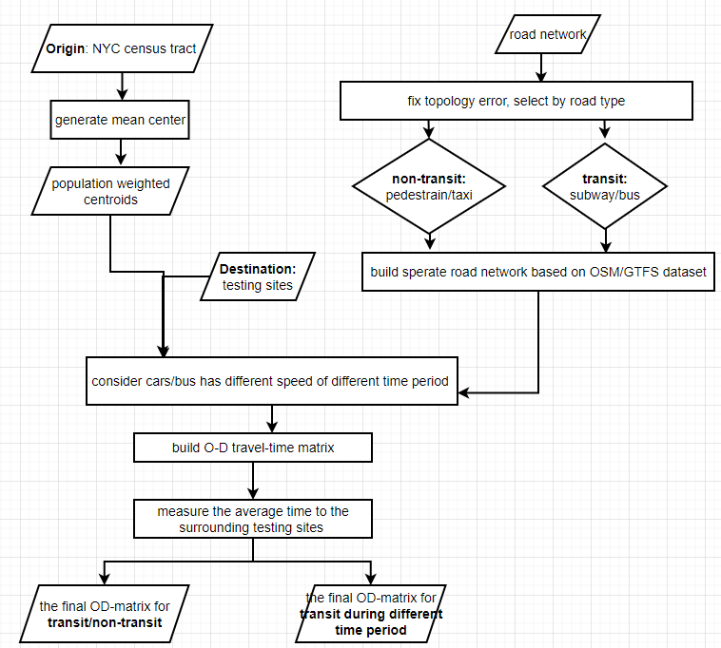
Next steps
Processed road network data
Create O-D travel time matrix
Measure accessibility of different transit modes
Compare transit V.S. non-transit accessibility
Notes:
That’s what I need to do in the future. So I will build road network of different transit modes and then calculate a O-D travel time matrix so that I can measure and compare the accessibility of different transit modes. I can see how transportation helps improve the accessibility to testing sites. Also, considering that cars have different speeds during peak or smooth period, I hope to explore the difference of accessibility during different time period.

Slide 10
THANKS
Q&A

